Slide 1
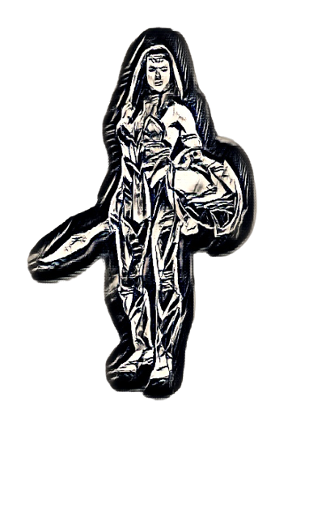
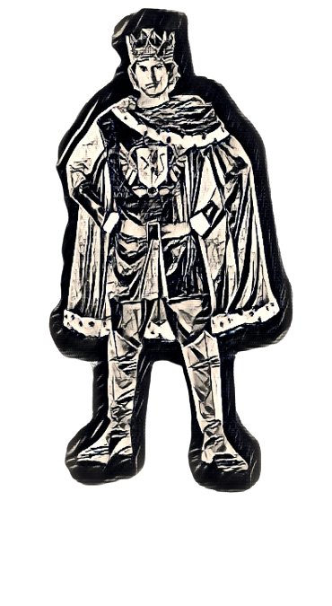
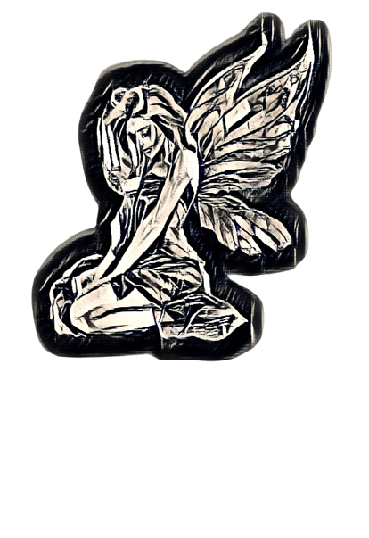
Aphrodite and the Mytheurology
league fight against
water pollution

Slide 2
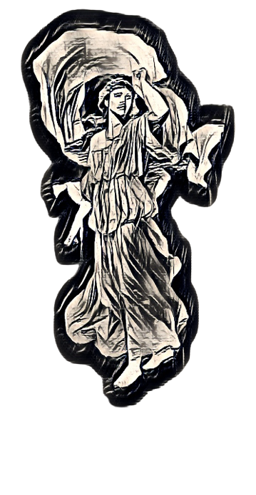
GODDESS APHRODITE IS TAKING HER DAILY
BEAUTY BATH AT HER PRIVATE SPRING IN CYPRUS
The water of the pond is no longer fresh and crystal clear. Besides, the waterfall gives off a strong and unpleasant smell!
Something is wrong!!!

Slide 3
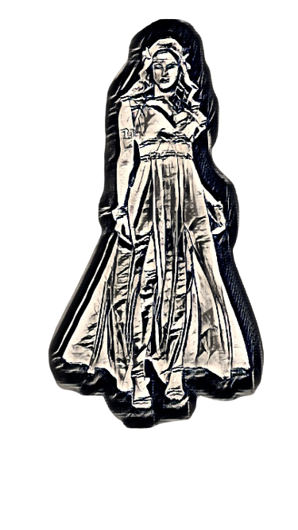
The farmers use tons of fertilizers and spray their crops with toxic pesticides!
They have poisoned the soil and the aquafer of the valley with chemicals !!!

Slide 4
Perhaps the water at the beach is safer ! I could enjoy a swim right now!

Slide 6
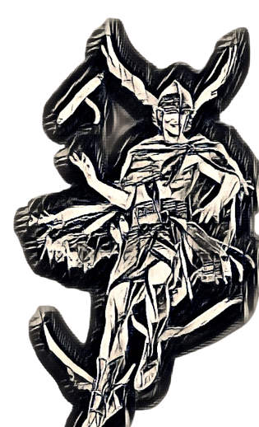

Slide 8
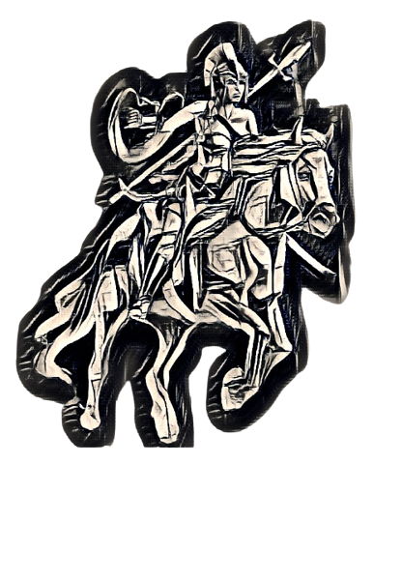

Slide 11
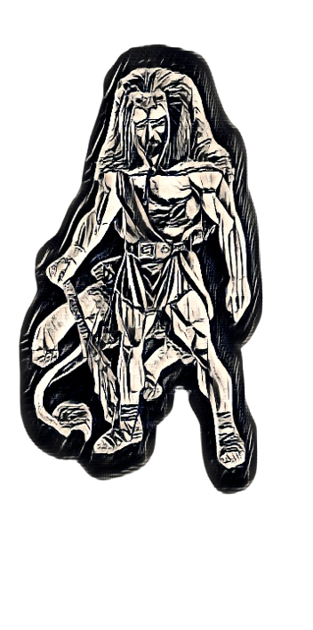

Slide 12
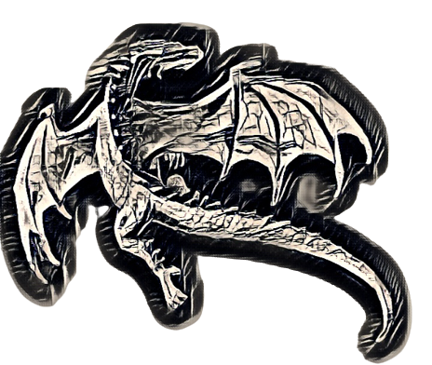

Slide 15
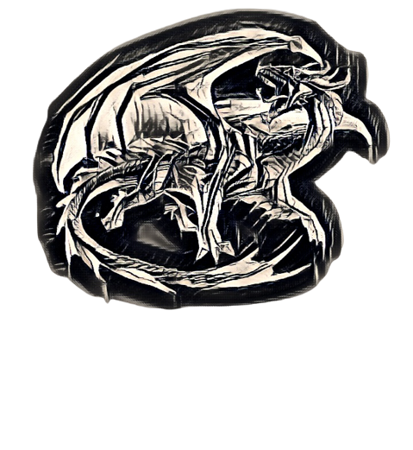

Slide 23
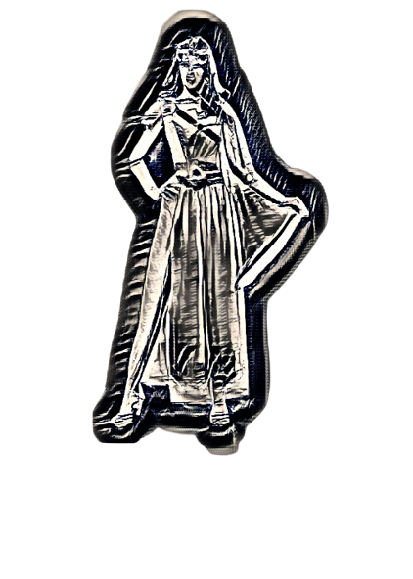

Slide 24
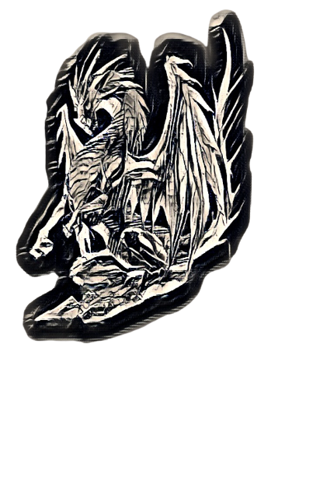

Slide 27
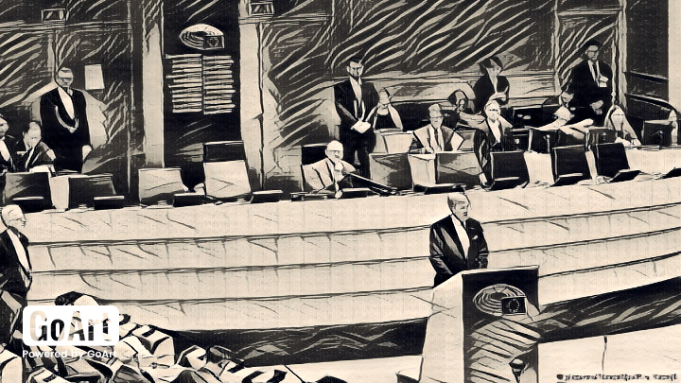

Slide 28
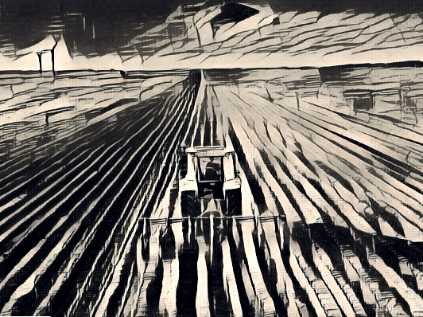

Slide 29
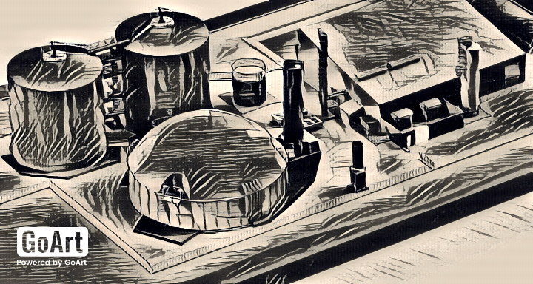

Slide 31
An environmental story
written and illustrated
by the students of the

